Slide 1

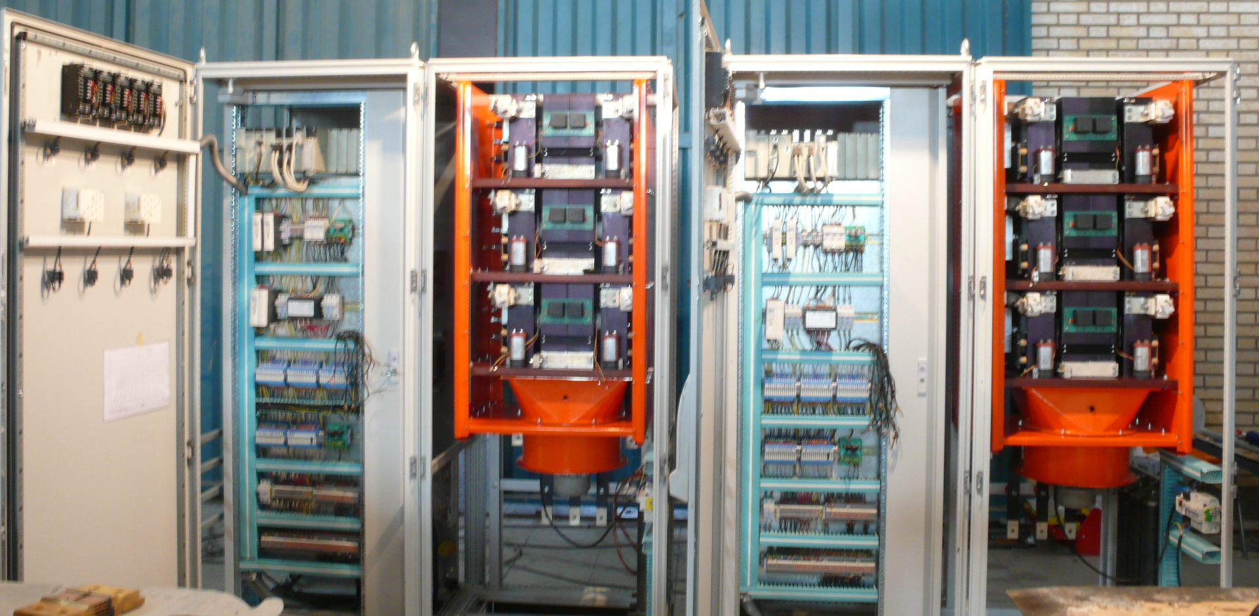
SECON-2000
Static Excitation Control System
Iranian Solution for Generator Excitation

Slide 2
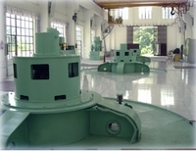
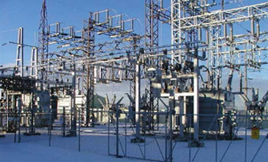
Subtitles
Introduction
Specifications
Standards, References
Main Parts of System
Q&A

Slide 3
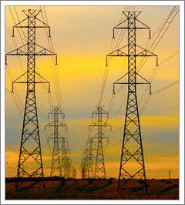
Definition
Excitation System Provides
DC Current for Generator
Field Winding
Single Generator
  Controls Generator Terminal Voltage
Connected to Network
  Controls Generator Power Factor
  Controls Generator Reactive Power

Slide 4

Different Types
DC
  DC Generator Commutator Exciter
AC
  Alternator Stationary Noncontrolled Rectifier
  Alternator Rotating Noncontrolled Rectifier
  Alternator Stationary Controlled Rectifier
STATIC
  Potential Source Controlled Rectifier
  Compound Source Noncontrolled Rectifier
  Compound Source Controlled Rectifier

Slide 5
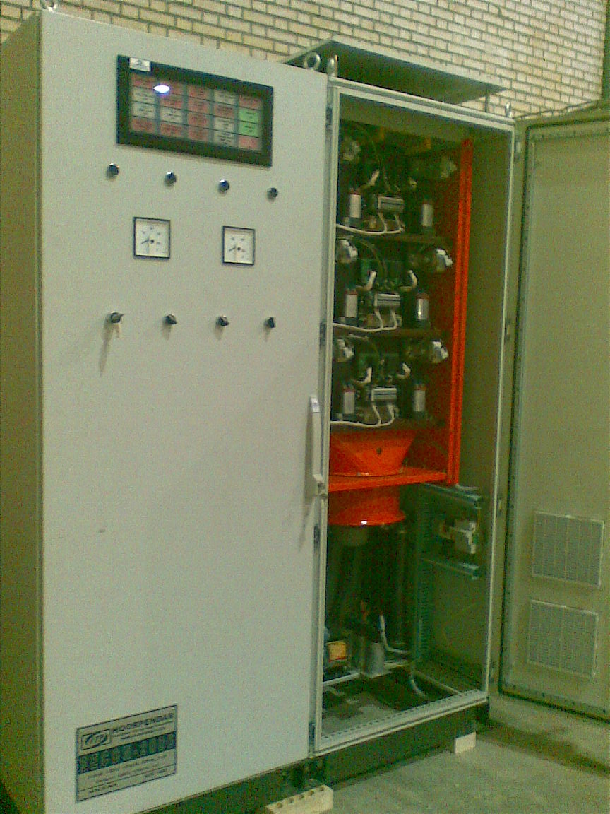
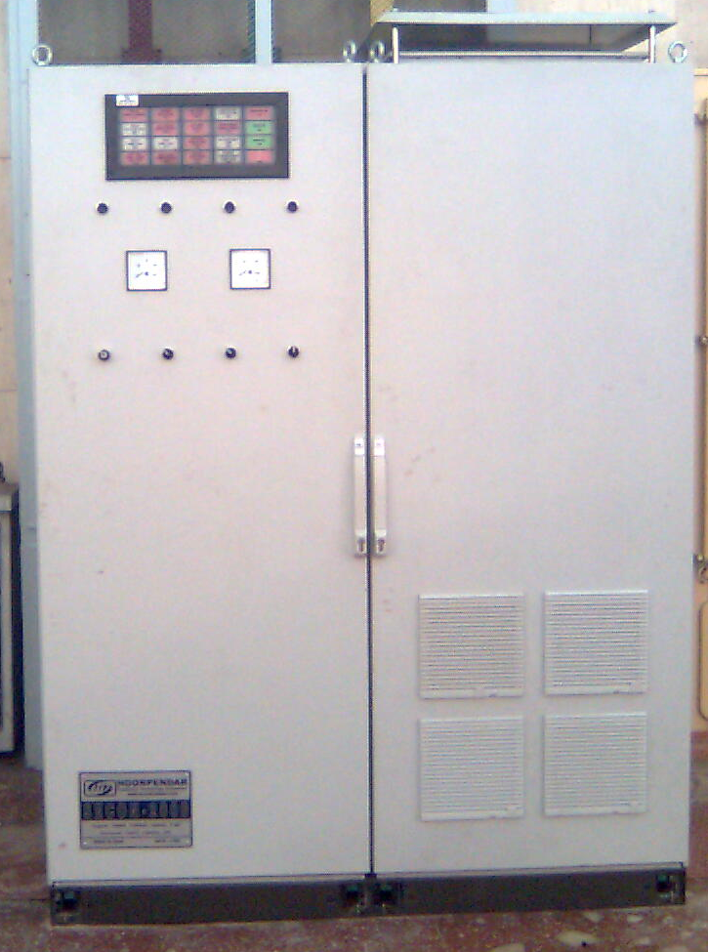
Specifications
Generator
  Stator:
    11MW, 10.5 KV, 50Hz
  Rotor:
    116V, 822A
Excitation System
  Input:
    160V, 1000A, 3Ø, 50Hz
  Output:
    160V, 1200A, DC

Slide 6
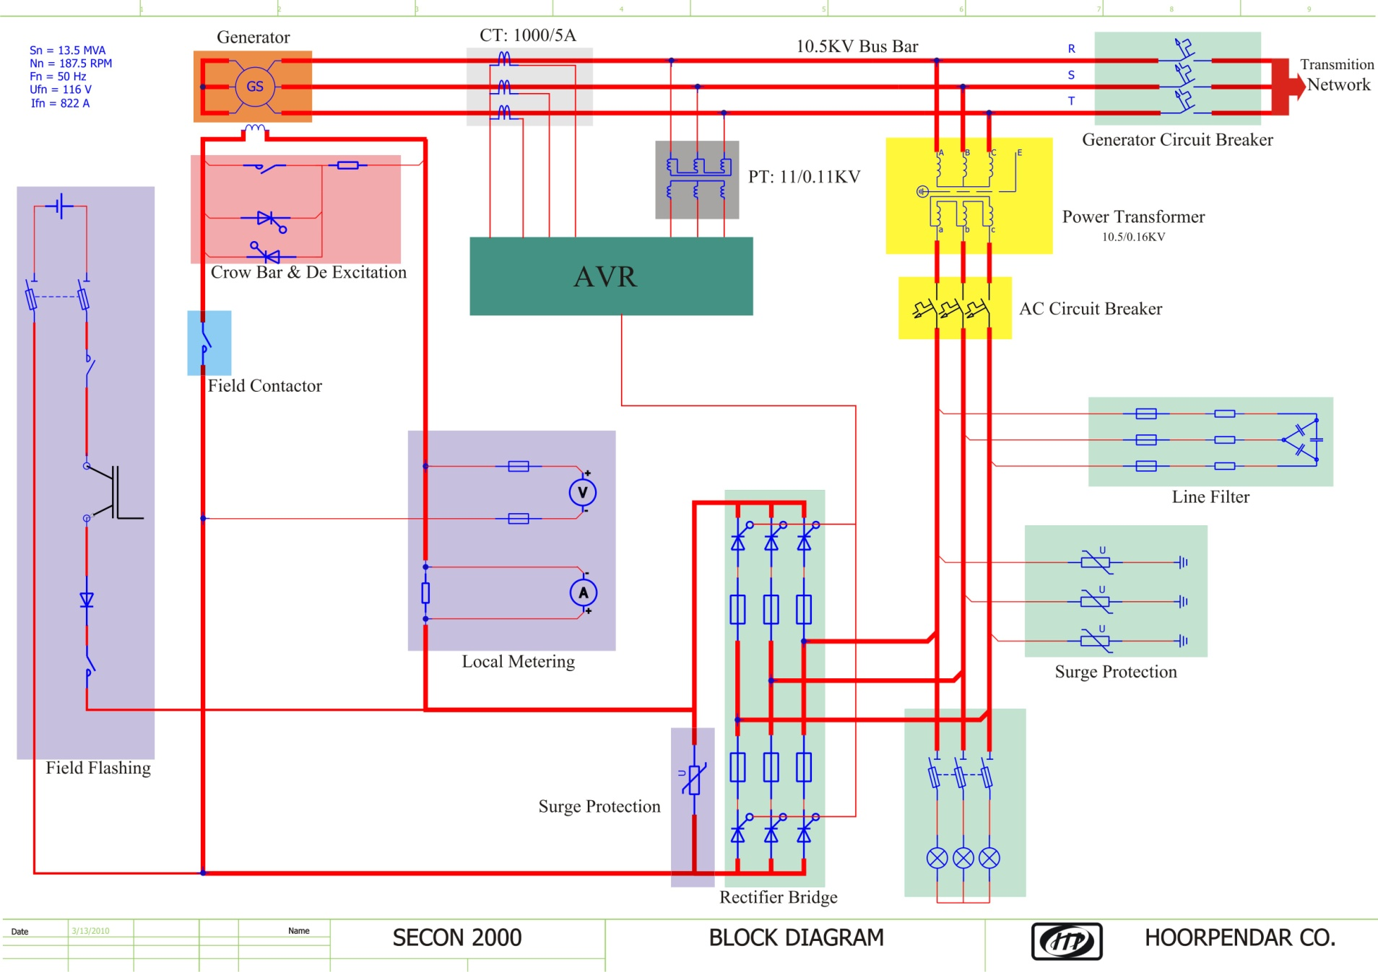
Electrical Diagram
AC
Tr
G
AC

Slide 7
Modes of Operation
Automatic
Single Generator
Terminal Voltage Regulator
Connected to Network
Power Factor Controller
Reactive Power Controller
Manual
Field Current Regulator

Slide 8
Standards
IEEE 421.1: IEEE Standard Definition for Excitation Systems for Synchronous Machines
IEEE 421.4: IEEE Guide for the Preparation of Excitation System Specifications

Slide 9
Standards
IEEE 421.2: IEEE Guide for Identification Testing and Evaluation of the Dynamic Performance of Excitation Control System
IEEE 421.3: IEEE Standard for High-Potential Test Requirements for Excitation Systems for Synchronous Machines
IEEE 421.5: IEEE Recommended Practice for Excitation system Models for Power System Stability Studies

Slide 10


References
EX2100: General Electric
Static Excitation System
UNITROL: ABB
Static Excitation System

Slide 11
Main Parts of System
Control
Power
HMI
Measurement
Protection

Slide 12
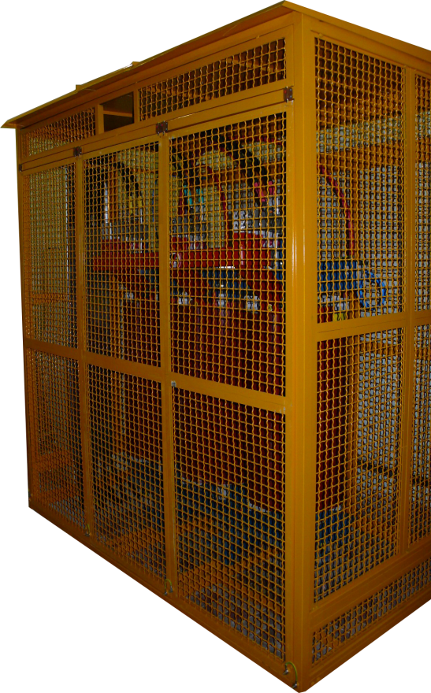
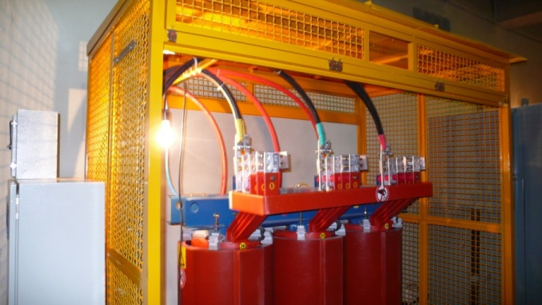
Power
Transformer
  Provides Ac Source
  for Rectifier Bridge
  Iran Transfo
  275 KVA
  10.6KV/152V
  Thermal Protection

Slide 13
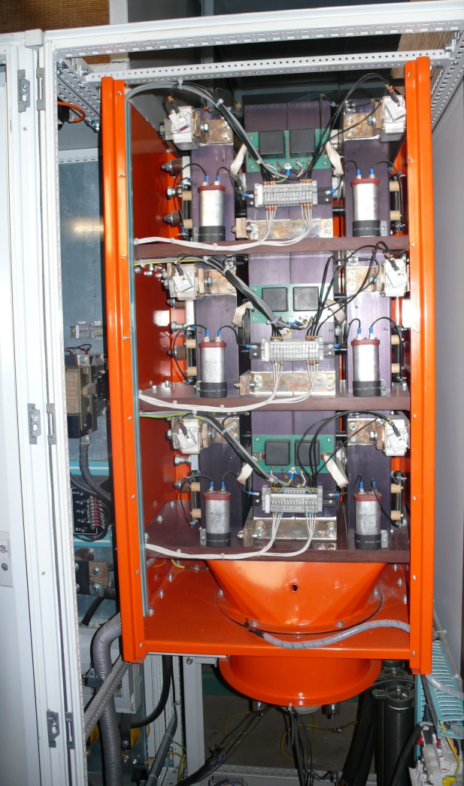
Power
Rectifier Bridge
  Rectifies AC Voltage
  to DC Controlled Voltage
  Six SCRs Full Controlled
  Rectifier
  Fuse Protection for Each SCR
  Forced Air Cooling Method
  Thermal Protection

Slide 14
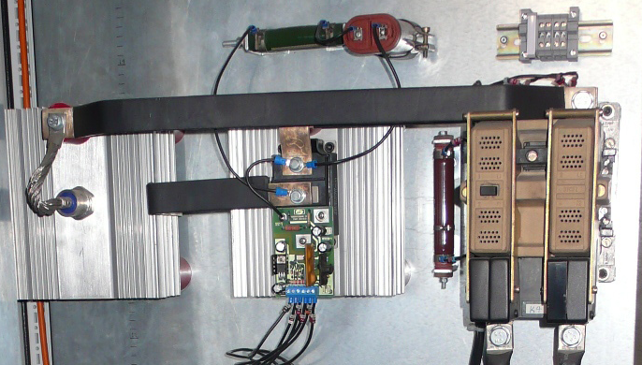
Power
Field Flashing
  Provides DC Current
  for Starting
  Controllable Starting
  Current Up to 300A
  Over Current Protection
  Short Circuit Protection

Slide 15
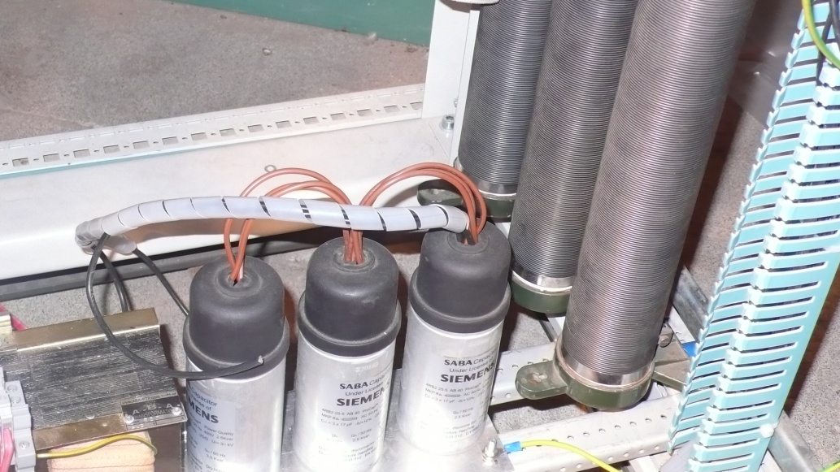
Power
Line Filter
  Enhanced Rectifier
  Bridge THD
  Reduces the Effect of
  Commutation Notch
  Enhanced Rectifier
  Power Factor
  Fuse Protection

Slide 16
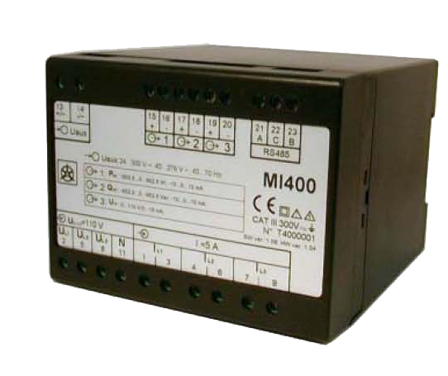


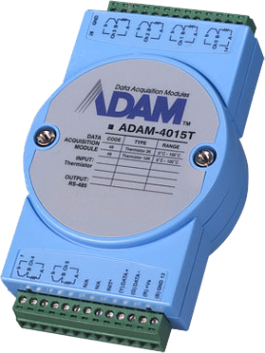
Measuring
Power Meter
  Generator Voltage
  Generator Power Factor
  Generator Reactive Power
Field Current
Field Voltage
Network Voltage
Battery Voltage
SCR Temperature

Slide 17
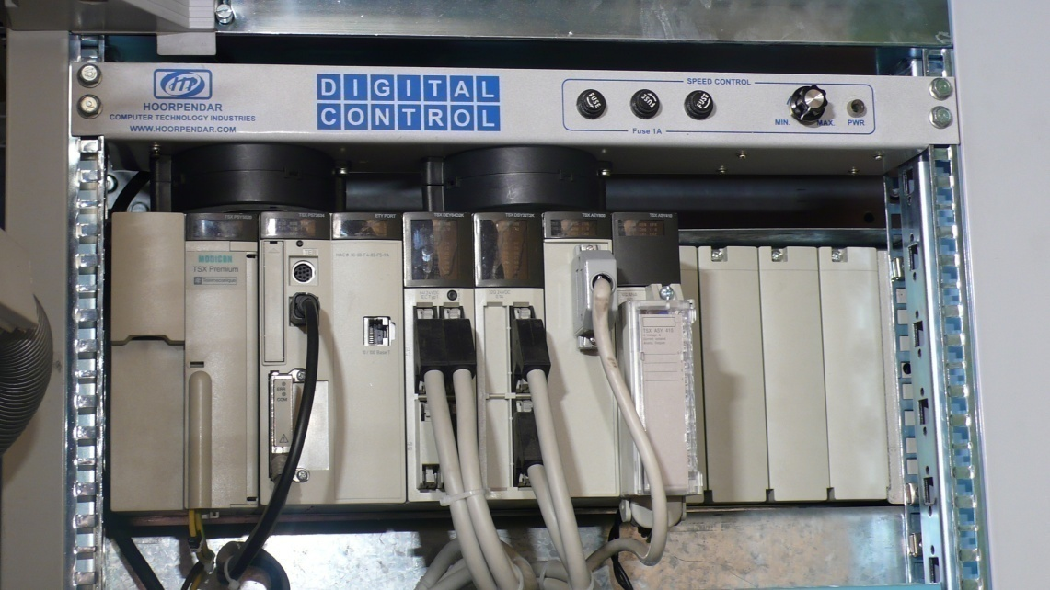
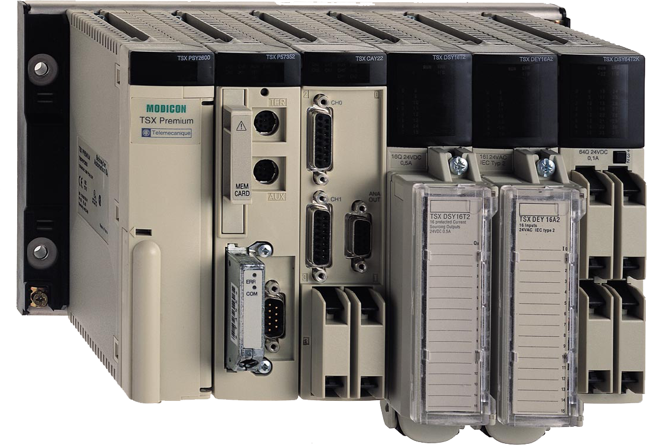
Control
Premium PLC
  1 CPU
  64 Digital Input
  32 Digital Output
  8 Analog Input
  4 Analog Output
  Network
    MODBUS
    Uni-Telway
    MODBUS TCP

Slide 18
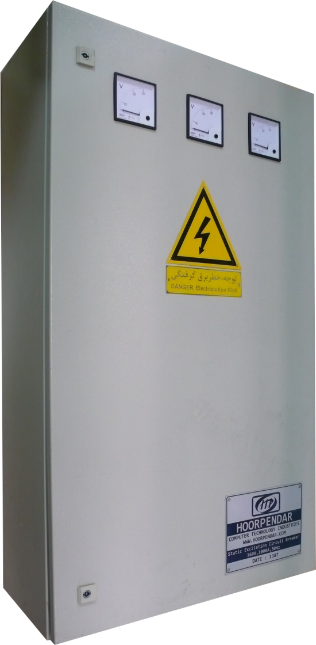
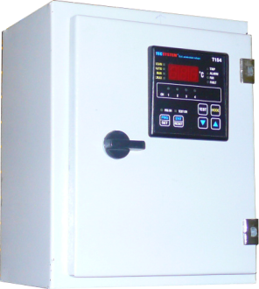
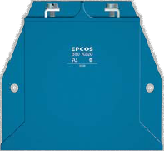
Protection
Hardware
  Over Current
  Phase Rotation & Lost
  Crowbar & De-excitation
  Transformer Over Temp.
  Surge Protection
Software
  Under Excitation
  V/F Protection
  Rotor Over Temperature
  SCR Over Temperature
  Short Circuit
  Over Voltage

Slide 19
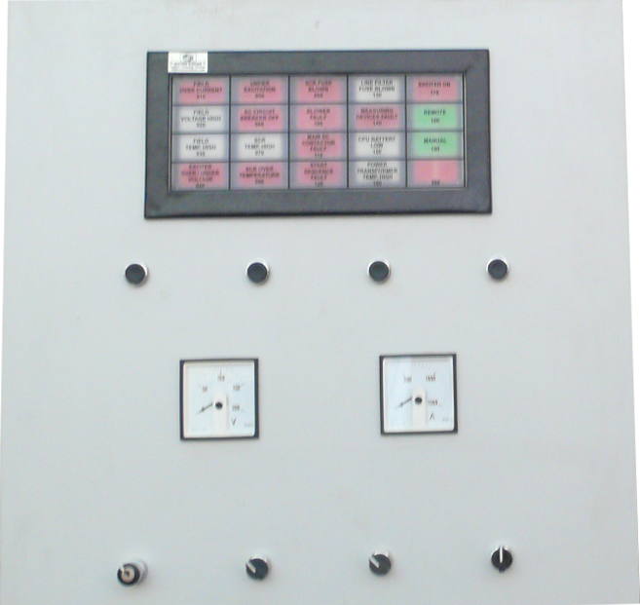
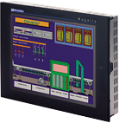
HMI
Operator Panel
  Alarm Annunciator
  Ammeter & Voltmeter
  Command Keys
  Sound Alarm
Programmable HMI
  Touch Screen
  Color
  5.7”

Slide 20
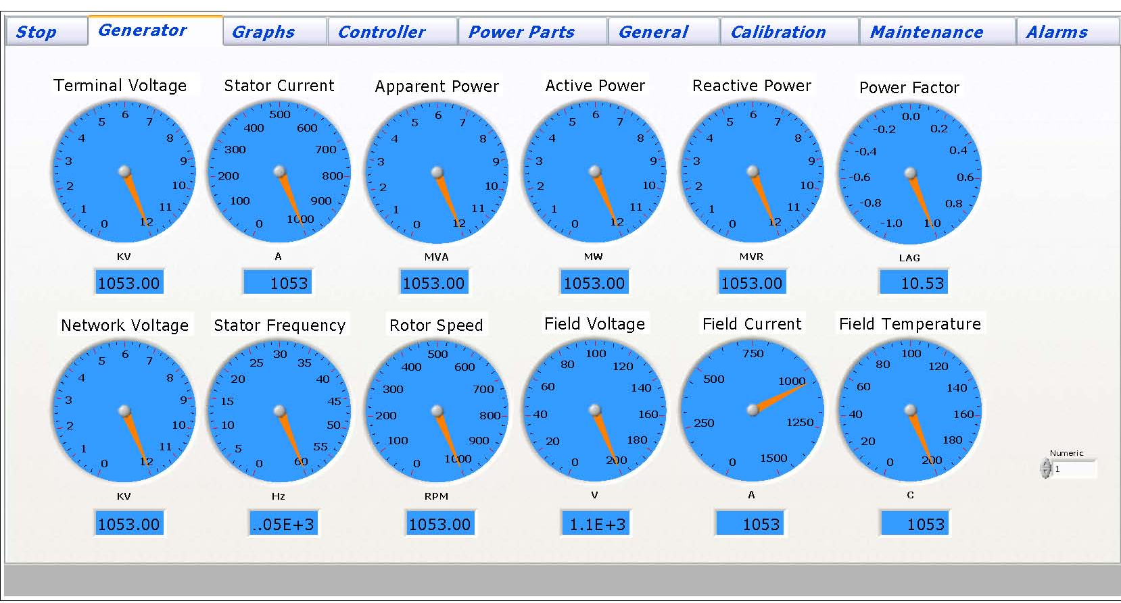
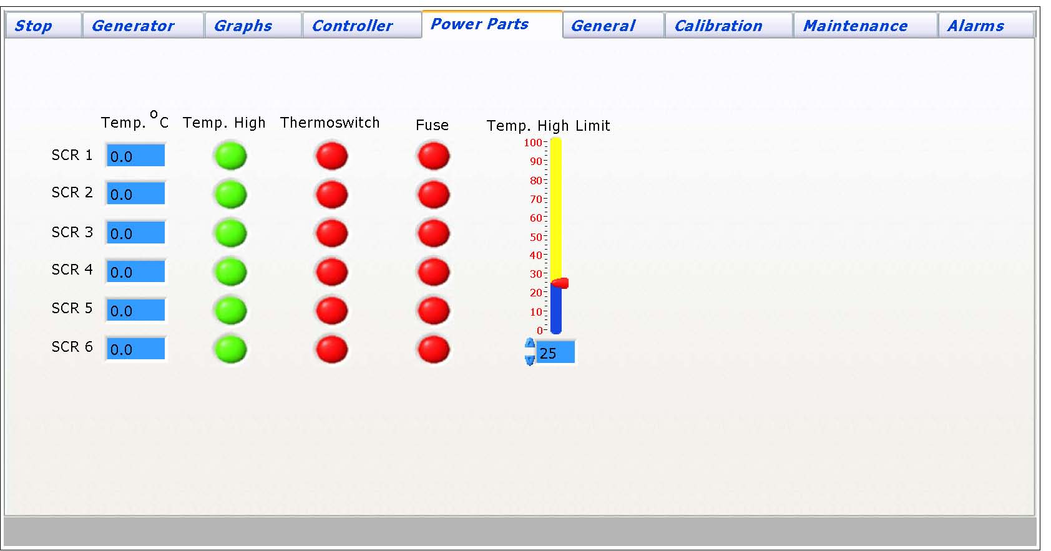
HMI
PC
  Monitoring
  Setting
  Log & Curve
  User Friendly
  GUI

Slide 21
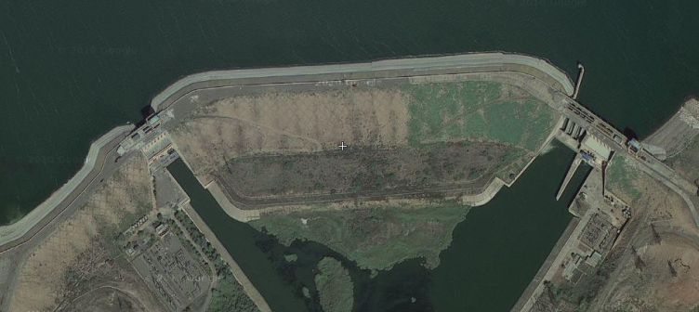
Q&A
Thanks for Your Attention!

